Slide 1
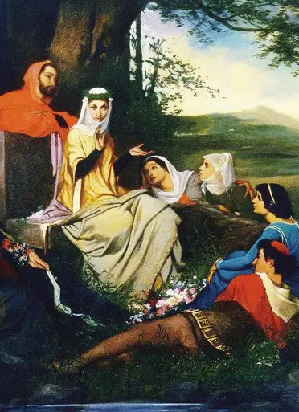

ISPIRATO DAL "DECAMERON" DI BOCCACCIO
"NON LE VOLLE NOMINARE PER LO PROPRIO NOME,CIOÈ FEMINE , MA DISSE: "ELLE SI CHIAMANO PAPERE"
LA NOVELLA
DELLE PAPERE
DAL 28 MARZO
AL CINEMA
BLUE SAMURAI PRODUCTIONS PRESENT SHATTERED ILLUSIONS STARRING MARIA SANCHEZ CAMERON HAYES ALEX RODRIGUEZ AND RACHEL KIM MUSIC BY BENJAMIN LEE EDITOR LILA CHEN PRODUCTION DESIGNER TYLER NGUYEN AND MAYA PATEL EXECUTIVE PRODUCERS ETHAN WILLIAMS LEO KIM AND HANNAH LEE WRITTEN BY JAKE THOMPSON OLIVIA BAKER AND ERIC CHEN DIRECTED BY JONATHAN ANDERSON

